Slide 1
Courseware
Basic Principles and Design

Slide 2
Courseware
Software that used to teach a lesson
  The media, either text, computer program, or CD-ROM, that contains the instructional content of the course (Babylon.com)
Examples:
  CAI (computer-assisted instruction); CAL (computer-assisted learning); CBL (computer-based learning)
  Web-based CAI
  PowerPoint

Slide 3
Advantages of CAI
Interactivity
Individualized instruction
  self-paced
  difficulty-adjusted
  personalized
Motivation
Immediate Response
Learner-control

Slide 4
Disadvantages of CAI
Hardware required
rigid learning process
programmed instruction

Slide 5
Types of Courseware
Drill and Practice
Tutorials
Simulations
Instructional games
Problem solving
Educational Resources
Application Software

Slide 6
Drill & Practice Software
Example: Electronic Homework, Vocab Builder
Training on specific skills
  immediate feedback
  can provide suitable quantity of quality training
  can provide individualized feedback
  motivate students with competition and multimedia
too much emphasis on drill & practice will sacrifice the development of problem solving abilities

Slide 7
Tutorials 個別輔導
呈現事實與規則,
例子以及問題
補救充份
學生應答
正確應答
不正確
計算機
評判
預備的補救
反饋
補救不充份
預備的材料可望奏效
診斷性提問
確定原因
補救
不充份
補救
錄自劉儒德, 教學軟件的選用與評價

Slide 8
Types of Tutorials
Linear: identical learning path
Branching: different learning paths according to student’s responses
Example:例: 波浪理論, 資訊科技大賽99

Slide 9
Advantages of Tutorial Software
Interactive
Individualize
Efficiently replace teacher when not available

Slide 10
Good tutorial software
With Objectives
with evaluation
tutoring process, e.g., gain attention and motivation; show objectives; background knowledge; display related information; examples; exercises; feedback; evaluation; help transfer to other situations (applications)

Slide 11
Simulations
Physical simulations: simulations of physical phenomena. 例: momentum, 資訊科技大賽99, Bunsen Burner, 資訊科技大賽99
procedure simulations: by controlling simulated devices, students learn the controlling procedure.
situational simulations: role-playing in a situation, learn through experience; decision-making.例: momentum, 資訊科技大賽99, Bunsen Burner, 資訊科技大賽99.
process simulations: by changing some settings, results of the process will be generated.

Slide 12
Advantages of Simulation Software
Much less-expensive compared with real situation
motivational
safe
near-real; authentic experiences
lower anxiety of failure

Slide 13
Instructional Games
Game as a factor to motivate students to learn. Example: 小動物與我, 繽紛都市
mostly a competition game, the objective is earn the highest score
good instructional game should be
  challenging
  arouse curiosity
  with imagination

Slide 14
Problem Solving
Software
Given a problem situation for students to solve
through solving the problem, students learn problem solving strategies, applying knowledge
Example: http://www.cse.cuhk.edu.hk/~mhp/all.html

Slide 15
Educational Resources
Dictionaries
Encyclopedia

Slide 16
Application Software
Word, Excel, Database

Slide 17
Learning Theories
Behaviorism
  classical conditioning
  instrumental conditioning
  behavior modification; shaping
Information Processing
Constructivism

Slide 18
學習的理論基礎
學習理論
Learning Theories
行為主義
社會學習學說
Behaviorism
Social Learning Theories
情境認知
識知理論
Situated Learning
Cognitive Theories

Slide 19
行為主義學派
行為主義
Behaviorism
古典制約
操作 (工具)制約
Classical Conditioning
Operant (Instrumental) Conditioning

Slide 20
古典制約
Classical Conditioning
Before Training:
Unconditioned Stimulus -- Food
Unconditioned Response -- Saliva
Training: A bell is rang when the food is given to the dog
After Training:
Conditioned Stimulus -- Bell
Conditioned Response -- Saliva

Slide 21
操作制約
Operant Conditioning
E
D
Trial & Error
Reinforced 強化
A
C
Behavior C has more chance to be repeated
B

Slide 22
對教育的影響
注重學習中的遊戲成份
注重獎勵, 競爭

Slide 23
社會學習學說
Social Learning Theory
學習不一定由於個人行為受到強化
而是由於觀察到他人的行為受到強化或懲罰,因而模仿這人的行為, 學習因而產生
學習是由於模仿他人而產生

Slide 24
對教育的影響
注重群體合作
塑造模範學生, 以作為其他學生的模仿對象

Slide 25
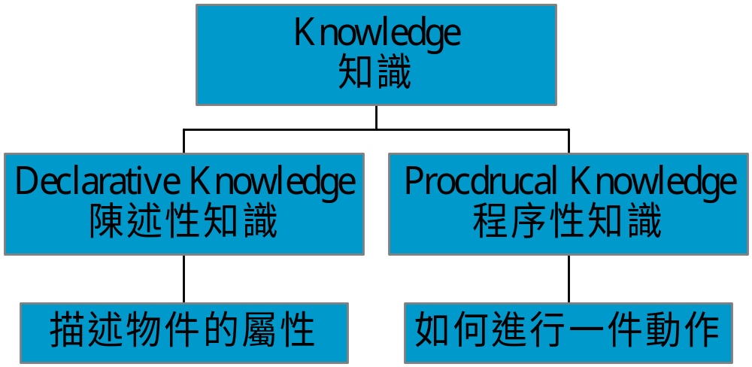
認知理論(一)
Cognitive Theories
Information Processing Model
7+- 2 units
Receptors Working Memory
Long-term Memory Effectors
Knowledge Compilation

Slide 26
認知理論(二)
Cognitive Theories
陳述性知識以組織方式貯藏於長期記憶中
陳述性知識以兩種方式貯藏: 語意(Semantic) 及影像 (Image), 因此促使學者形成心像 (Mental Image) 可協助記憶

Slide 27
Skill Acquisition 技能習得
文字描述
動作
操練
按指示進行
自動化

Slide 28
對教育的影響
導引注意力於重點處
促進自動化
組織教材, 協助學生記憶
利用心像 (Mental Image) 以協助學生記憶
不同知識採用不同之教學方式

Slide 29
情境認知
Situated Learning
知識與情境不可分割,因此學習不可脫離情境
學習者是完整的個體, 其主動探索可自我管理的能力, 是學習成效的重要關鍵

Slide 30
對教育的影響
Discovery Learning 發現學習法
Constructivism 建構主義

Slide 31
Applied to the design of courseware
Teaching process agrees with learning processes
individualized
interactivity, to
  ensure information received
  encourage response, which helps memorization
  feedback
  lengthen learning time at points required

Slide 32
Suitable amount of learner control
  structure of learning materials shown
  easy leave or enter each unit
Interface design
  one page for one point (1 or 2 sentences)
  student control the pace
  help menu
  student record

Slide 33
Courseware Design
Display
  navigation
  instruction or help on how to use the system
  display of students’ input
  text not too long, consistent style
  suitably use of blink, inverse,.. to emphasize
  suitably use of sound effect, colour, graphics, animations

Slide 34
Techniques to increase learning effect
  scaffolding -- advance organizer
  repetition
  revision
  comparison
computer-control versus learner-control
feedback: immediate or delayed, true-false or diagnostic

Slide 35
Evaluation of courseware
Ways of Evaluation: Expert Review; Field Test, Experiment.

Slide 36
References
http://ccism.pc.athabascau.ca/html/ccism/deresrce/theory.htm
http://carbon.cudenver.edu/~mryder/itc/constructivism.html
http://www.kilvington.schnet.edu.au/construct.htm
http://metric.ma.ic.ac.uk/~pkent/construction/construction.html

